Slide 1
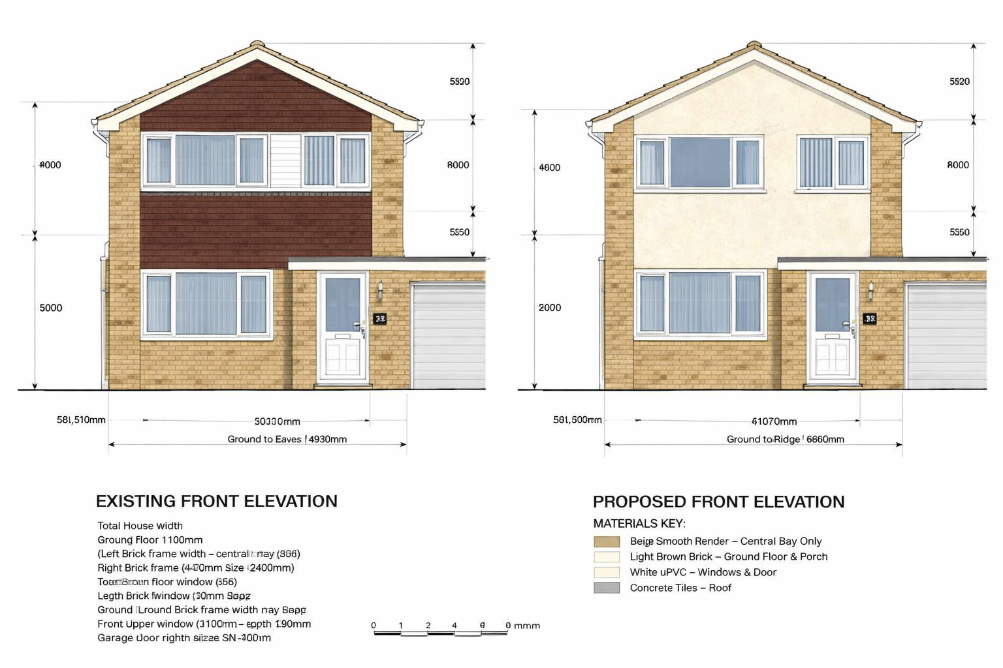
UPVC Cladding
470 mm Wide
1030 mm High
1330 mm
Window
2400 mm Wide
1030 mm High
Window
1200 mm Wide
1350 mm High
1180 mm
5414 mm
1610 mm
Window
2400 mm Wide
1350 mm High
2720 mm
1350 mm
Door
890 mm
2240 mm
Garage Door
220 mm Wide
2020 mm High
940 mm
3020 mm
2210 mm
7870 mm
5190 mm
Property: 10 Heron Close, Calne, SN11 8PJ Applicant: Alison Day Planning Ref: PL/2026/03956 Drawing Title: Existing & Proposed Front Elevations Required Scale: 1:50 Date: 21 July 2026
0 0.5 1.0 1.5 2.0 2.5 m

